Slide 1



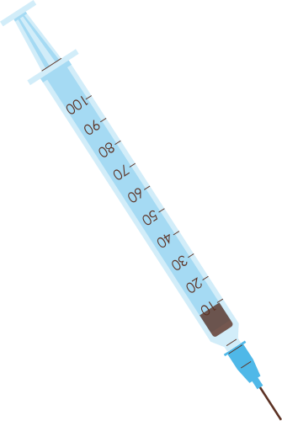







TELEMEDICAL & AI HEALTH CARE
Created by: HackInTech

Slide 2
CHALLENGES FACED BY US IN HEALTHCARE SECTOR
According to the WHO, the ideal doctor-patient ratio is 1:1000, but in West Bengal, a government doctor caters to 10,411 patients (National Health Profile report).
Rural communities face significant challenges in accessing healthcare services due to the long distances they must travel to reach healthcare facilities.
Error are not very uncommon in case of a diagnosis, so people often opt for a second opinion in some other state by some well known doctors, but this always takes up a lot of resource and time, and thus raises the chances for worsening the patient’s condition.

Slide 3

OUR OBJECTIVE
The primary objective of Doctor.AI platform is to provide an innovative and user-friendly solution for individuals to interact and receive predictions related to their diseases using machine learning models.
The platform aims to utilize advanced AI technologies, such as natural language processing and image analysis, to enable users to engage in informative chats about their health concerns.
The goal is to empower users with fast and reliable healthcare insights, fostering better disease awareness and early intervention for improved health outcomes.

Slide 4



BRAIN TUMOR
RAW
DATA
SET
PREPROCESSING
RAW
DATA
PNEUMONIA
MRI
MODEL
MODEL
CANCER DETECTION MODEL
LUNG CANCER
CT
SCAN
MODEL
USER
IMAGE
INPUT
PROCESSING USER
INPUT
PREDICTION
WITH
95%
ACCURACY
DOCTOR
AI
RESULT DISPLAY
LUNG
CANCER
MODEL
CANCER
DETECTION
MODEL
MAKE
APPOIN-
TMENT
SCHEDULE AN APPOINTMENT WITH
SELECTED DOCTORS
JOIN
MEETING
END

Slide 5


TYPE OF CANCER
ADENOCARCINOMA
SQUAMOUS
Adenocarcinoma develops from the cells that line the internal or external surfaces of organs or glands.
It is characterized by abnormal growth of squamous cells, often forming flat, scale-like structures.

Slide 6
TYPE OF MALIGNANT LUNG CANCER
LARGE
CARCINOMA
ADENOCARCINOMA
SQUAMOUS
Adenocarcinoma develops from the cells that line the internal or external surfaces of organs or glands.
Large cell carcinoma is a type of non-small cell lung cancer (NSCLC).
spread more rapidly than other types of NSCLC
It is characterized by abnormal growth of squamous cells, often forming flat, scale-like structures.

Slide 7
TYPE OF PRIMARY BRAIN TUMOR
GLIOMA
MENINGIOMA
PITUTARY
Gliomas are tumors that develop from glial cells. They include astrocytomas, oligodendrogliomas, and ependymomas.
Meningiomas arise from the meninges, the protective membranes covering the brain and spinal cord.
These tumors develop in the pituitary gland, which is located at the base of the brain.

Slide 8
TYPE OF PNEUMONIA
PNEUMINIA
NORMAL
Gliomas are tumors that develop from glial cells. They include astrocytomas, oligodendrogliomas, and ependymomas.
Meningiomas arise from the meninges, the protective membranes covering the brain and spinal cord.

Slide 9




TECH STACK OF SOLUTION DEVELOPMENT
Doctor.AI was built using Intel oneAPI for accelerated computing, leveraging machine learning models. The backend was developed using Flask, Node.js, Express. while the frontend utilized React, creating a powerful and efficient tech stack for seamless healthcare AI applications.

Slide 10

FUTURE GOALS
With the help of Medical and Technical experts we want to create one SUPER MODEL which can detect various diseases.
Our own General Chat model for Health related queries.

Slide 11
THANK YOU!
Thank you so much Hack4Bengal for this opportunity. We would happily appreciate any feedback for improving our platform

